Slide 1

Mystic Warrior Concept Document
APlus Associates

Slide 2
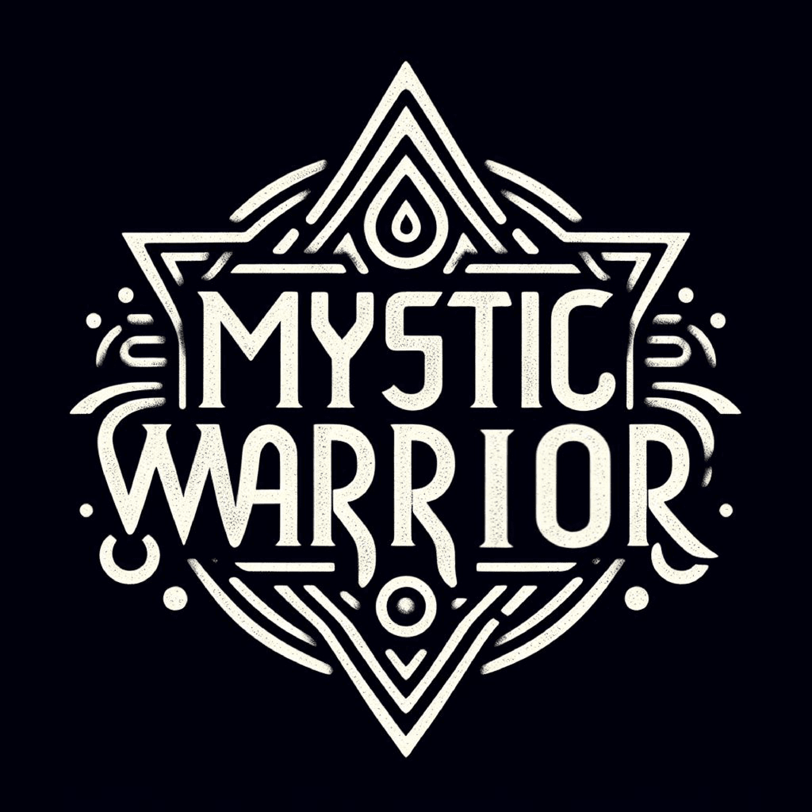
Introduction
Genre:
Action-adventure, Soulslike combat, Indian mythology-based fantasy
Overview:
Drawing inspiration from Indian Mythology and Kalaripayattu martial arts, Mystic Warrior delivers immersive storytelling, challenging combat, and deep lore akin to soulslike games.
Players assume the role of a warrior confronting various asuras, employing strategic combat, elemental magic, and exploration to emerge victorious.
Player's Role & Objectives:
Players embody a skilled warrior set on vanquishing the powerful asuras.
Goal is to navigate perilous environments, battle foes, uncover secrets, and ultimately defeat powerful asuras and its minions using strategic combat, elemental magic, and exploration.

Slide 3
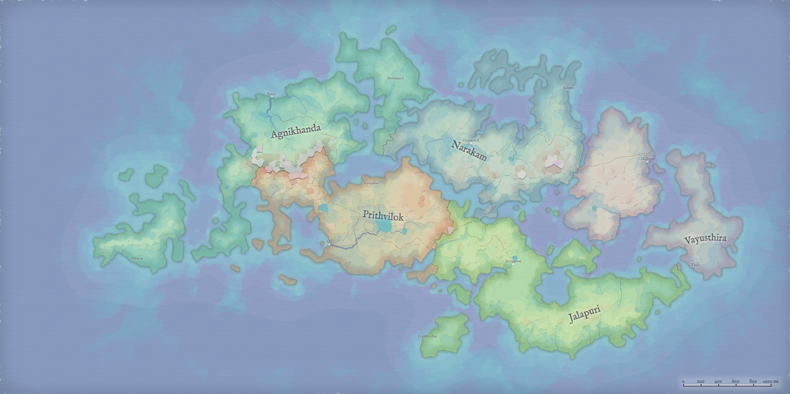
Story & Setting:
Game Narrative Overview:
Mystic Warrior thrusts players into a world where ancient Indian mythology intertwines with the art of Kalaripayattu martial arts. The protagonist, a skilled warrior, learns of the resurgence of malevolent Asuras led by the formidable Hiranyaksha. Determined to restore balance, they embark on a perilous journey to confront these ancient evils.
Introduction to the Game World's Setting:
Set against a backdrop of mystical landscapes and sacred temples, Mystic Warrior immerses players in a world steeped in Indian mythology and martial prowess. From the towering peaks to the ancient ruins of lost civilizations, each location is rich with history and cultural significance. The attire, architecture, and characters' aesthetics reflect the vibrant tapestry of Indian folklore, creating a visually captivating and culturally immersive experience. As players delve deeper into the game world, they uncover the secrets of a bygone era and the enduring struggle between light and darkness.

Slide 4
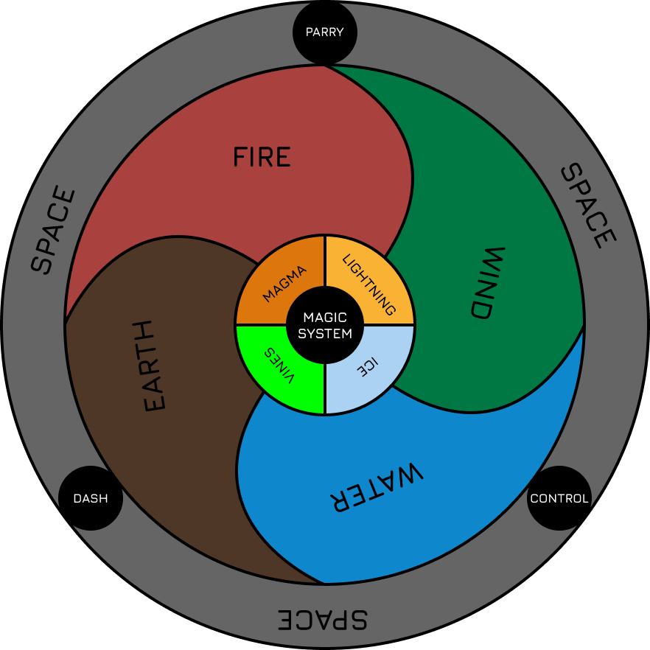
Game Mechanics
Combat System
Strategic combat inspired by Kalaripayattu martial arts.
Weapons with elemental affinities: water, fire, wind, earth.
Varied attack types and combat actions for precise timing and defense.
Magic System:
Five elemental affinities: fire, water, earth, wind, space.
Cast spells, manipulate objects, and enhance combat with elemental magic.
Combine elements for devastating combo attacks and strategic maneuvers.
Exploration & Puzzle-Solving:
Navigate interconnected environments with traps and hidden secrets.
Solve puzzles using elemental magic, environmental interactions, and strategic exploration.
Discover hidden passages, lore fragments, and valuable rewards.

Slide 5
Progression and Objectives
Level-Based Progression:
Players progress through the game via levels, each offering unique challenges, environments, and story elements.
Each chapter corresponds to a significant milestone in the protagonist's journey, leading towards the ultimate confrontation with the Asura Hiranyaksha.
Defeat the Asura Hiranyaksha:
The primary objective of the game is to confront and defeat the powerful Asura Hiranyaksha, who threatens the realm with its reign of terror.
To achieve this goal, players must navigate through treacherous environments, battle enemies, solve puzzles, and overcome formidable bosses and mini-bosses.

Slide 6
What’s Unique?
Indo-Fantasy
Kalaripayattu
Elemental Magic
A rich world steeped in Indian mythology, featuring epic landscapes and mythical creatures.
Master fluid and dynamic combat styles drawn from the ancient martial art of Kalaripayattu.
Devastating combo attacks using panchabootha: fire, water, earth, wind, and space.
Strategic Exploration
Deep Lore
Precise Combat
Navigate treacherous environments, solve puzzles, and uncover hidden secrets.
An immersive storytelling experience filled with intriguing characters and epic quests.
Challenging and strategic combat requiring precise timing and skillful dodging.

Slide 7





Platforms and Technologies
Blender
Unreal Engine 5
Rokoko Studio
Blender's intuitive interface and comprehensive feature set empower our team to iterate rapidly, iterate efficiently, and bring our creative vision to life with precision and finesse.
With Unreal Engine 5's robust tools and workflows, we create breathtaking environments, fluid animations, and intense combat encounters that transport players to the heart of Indian mythology.
The use of Rokoko technology revolutionizes character animation and brings an unprecedented level of realism and fluidity to the game's combat system.

Slide 8
Milestones
DESIGNING
PLAY TESTING
Focus on Level Design and Story Narration And Narrative Design as a whole
We do a proper check for all bugs and work on fixing them
2024
Q3
2025
Q1
Q2
2024
Q4
2025
Q2
2025
PROTOTYPING
UPGRADING
TEST LAUNCH
We plan to finish up implementation and prototyping
Optimize the old systems, add new functionalities and improve performance
We take in feedback on what has been done and work on improving gameplay for players

Slide 9
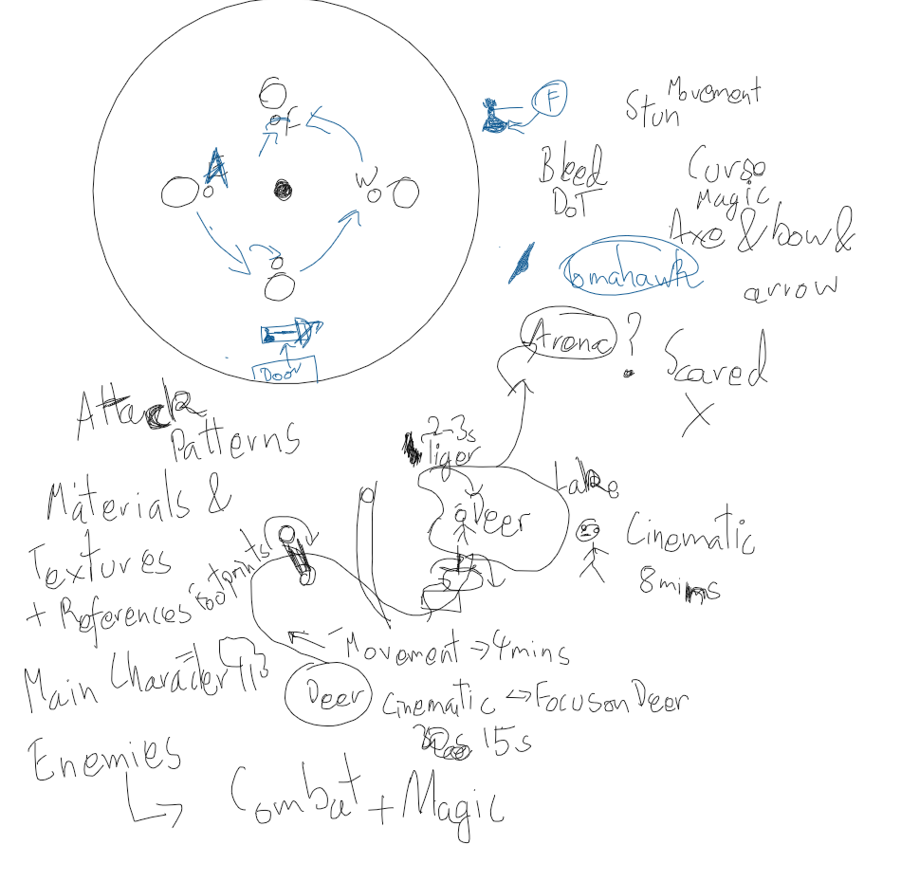
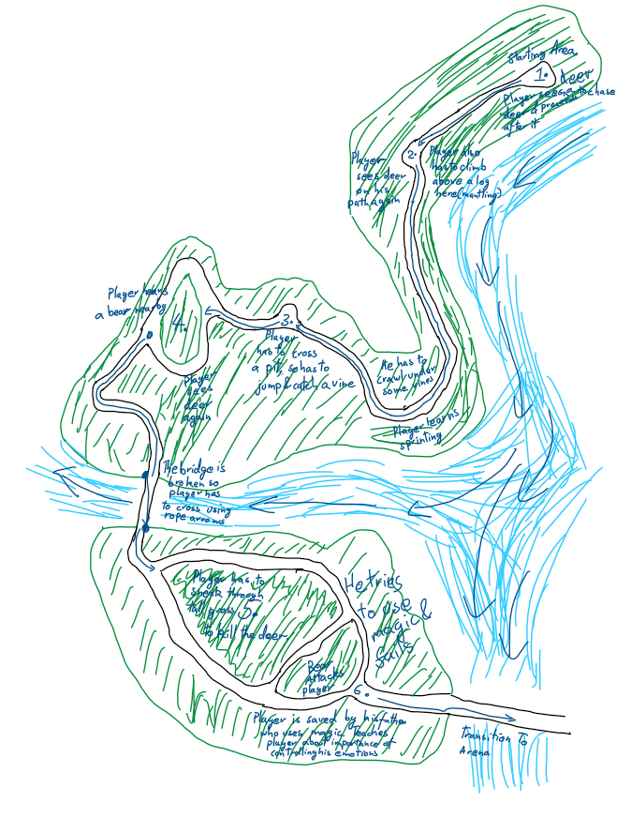
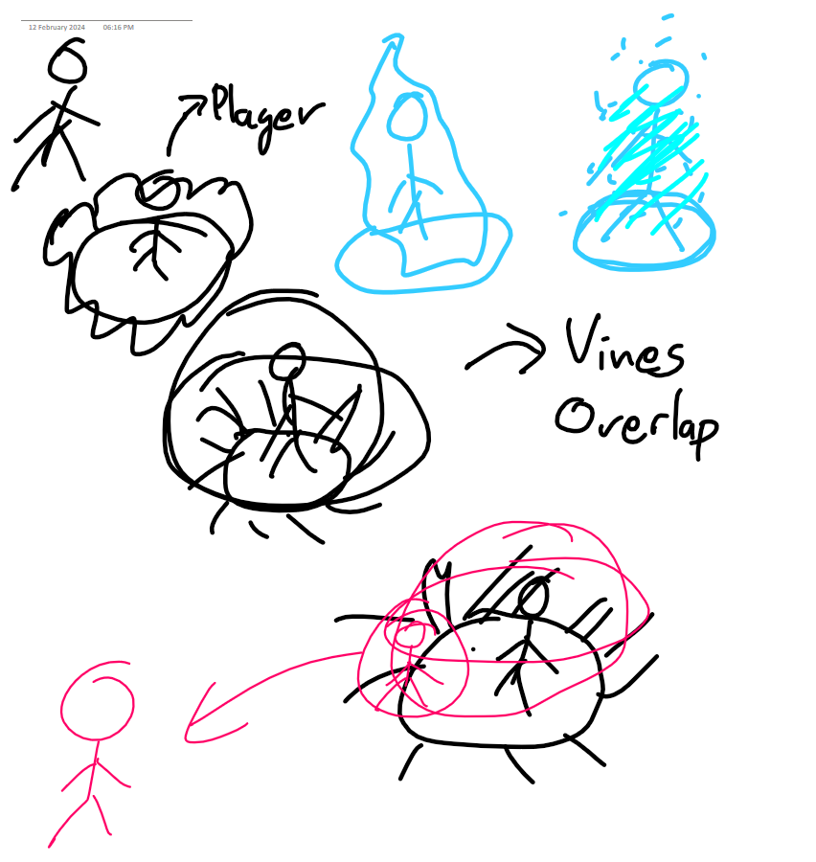
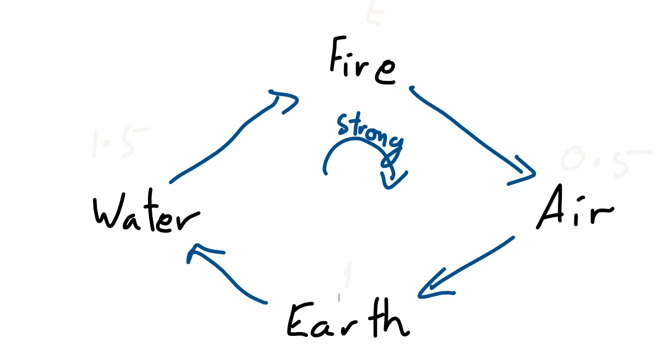
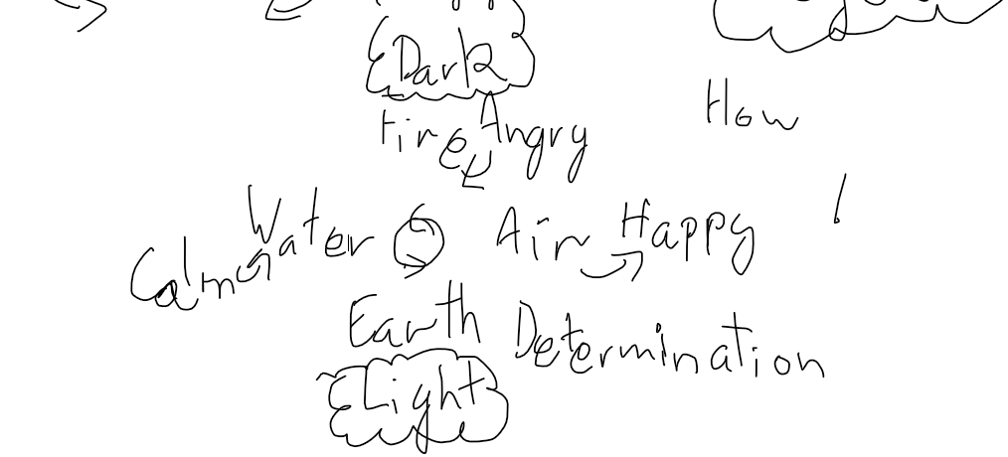
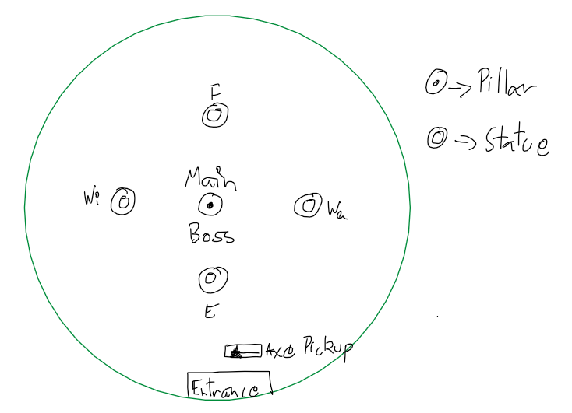
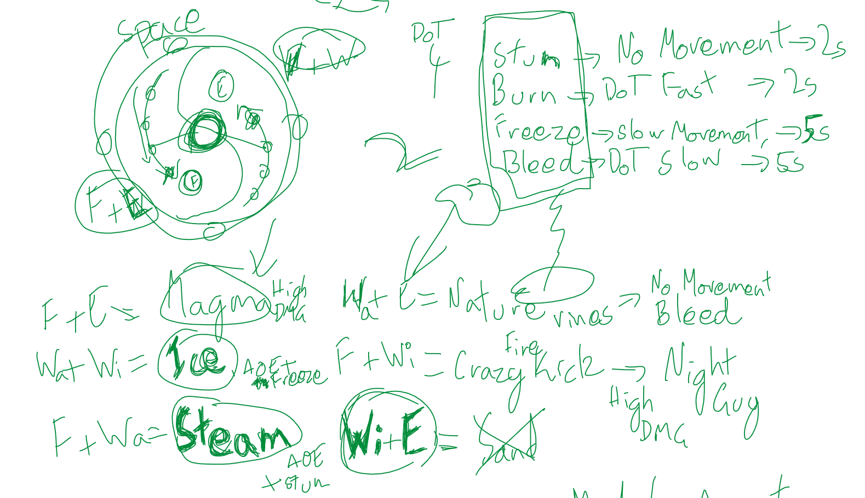
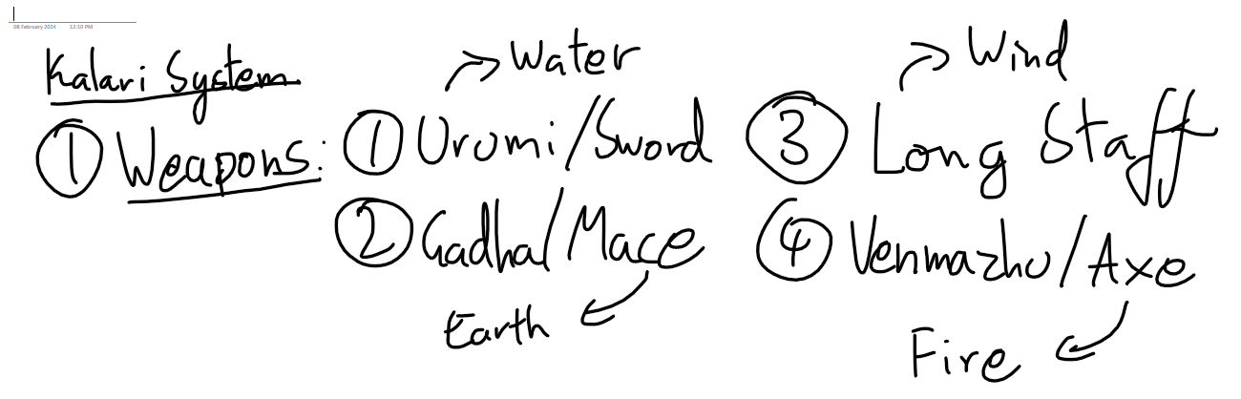
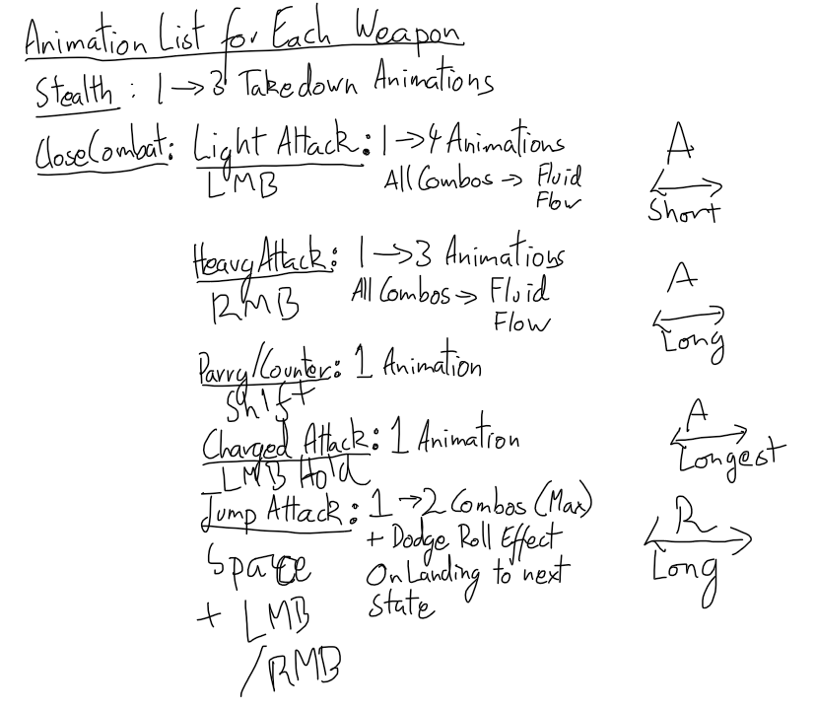
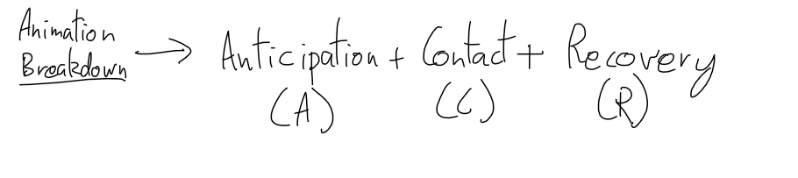
Concept Workflow

Slide 10
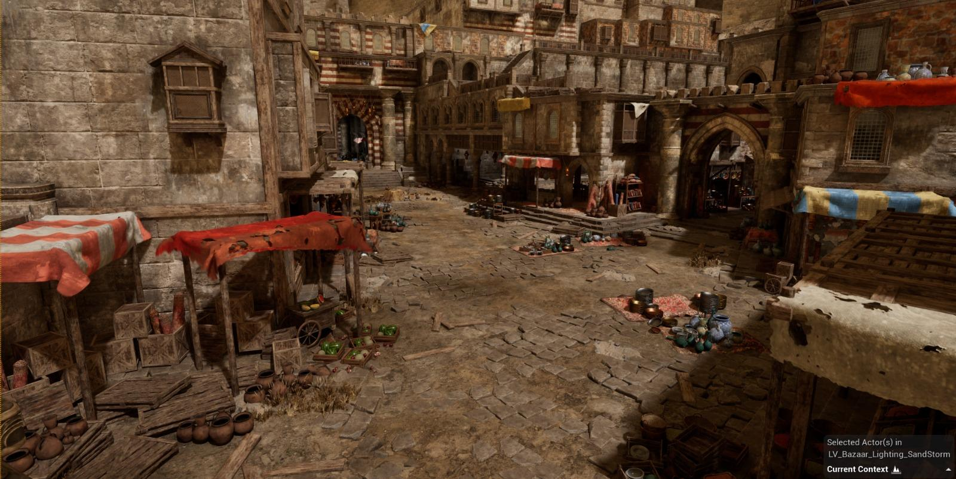
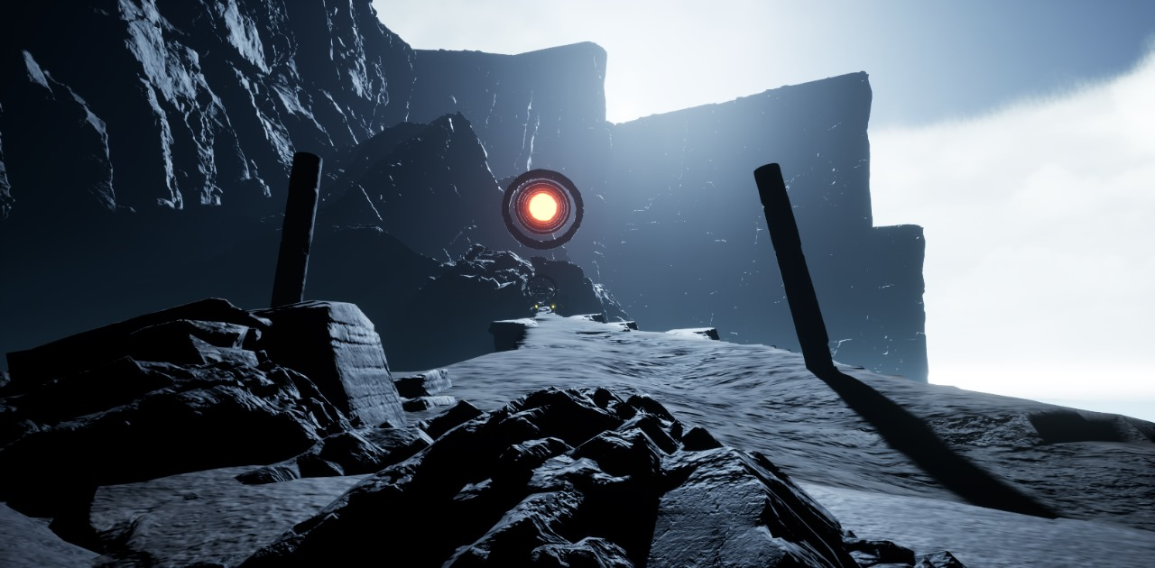
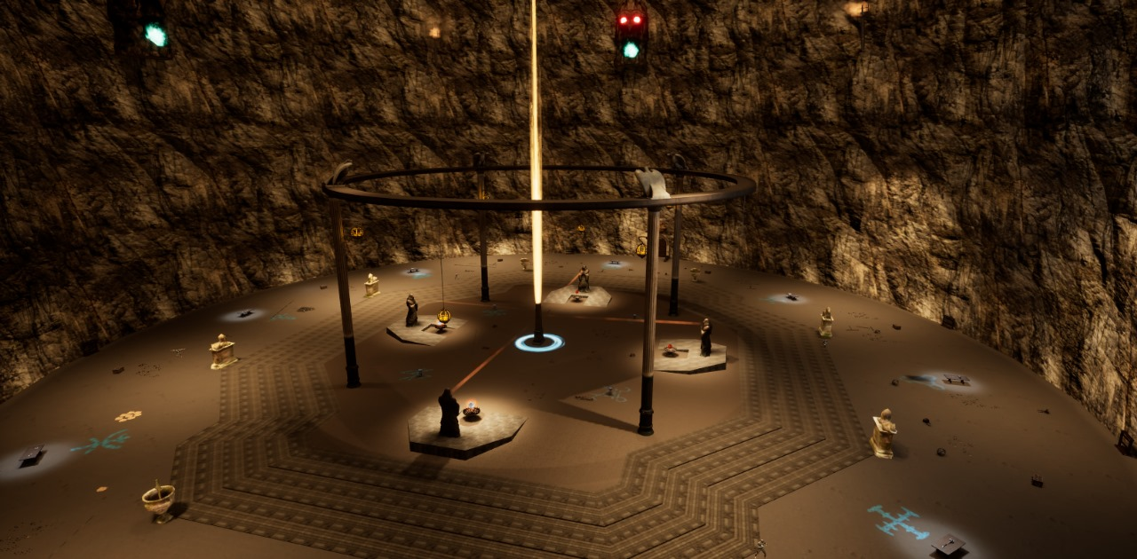
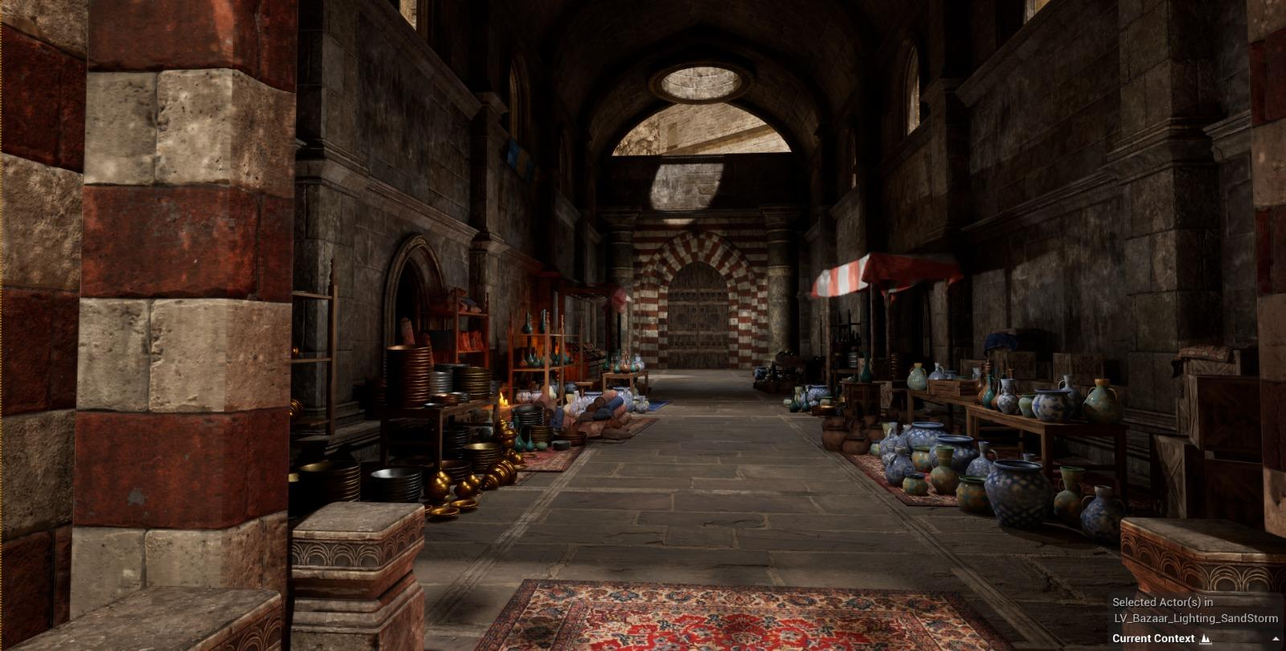
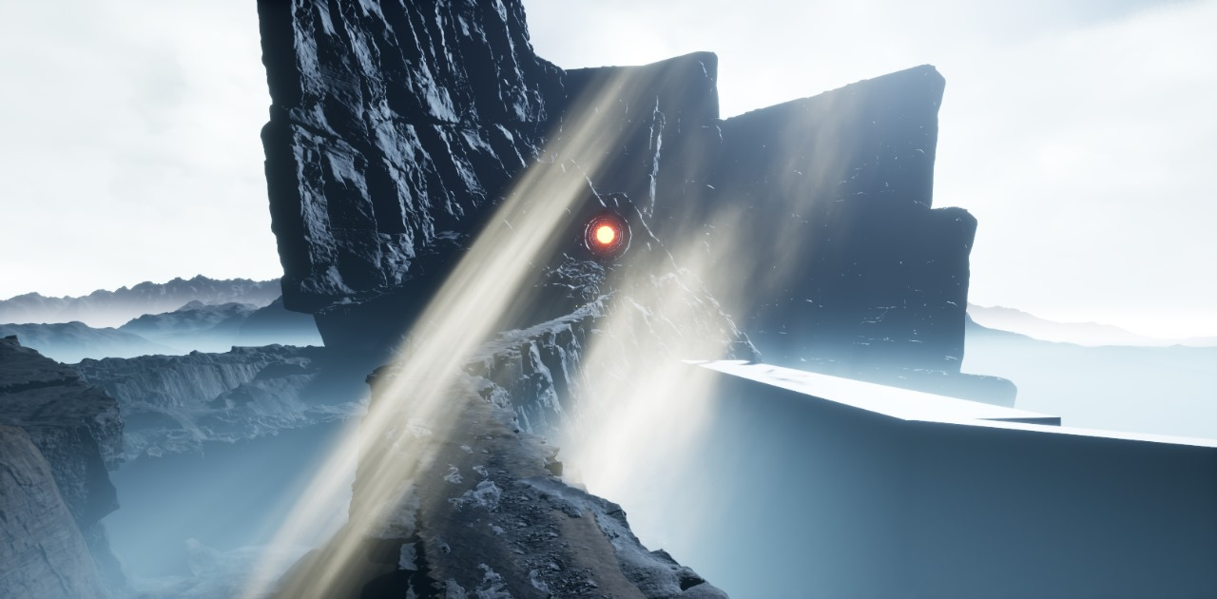
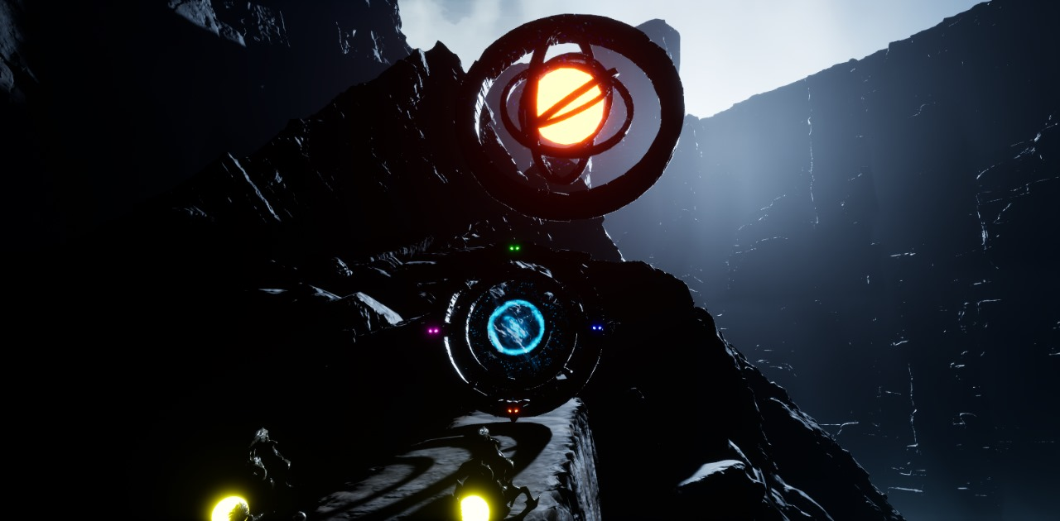
Game Environment

Slide 11
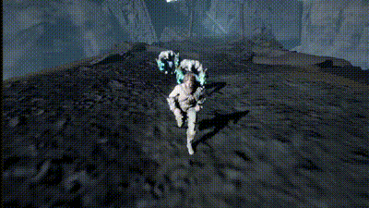
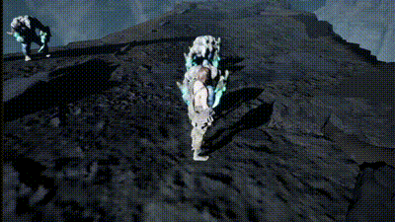
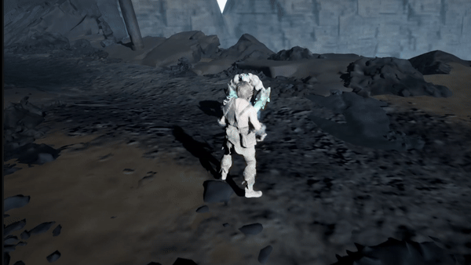
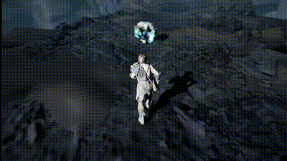
Combat System

Slide 12
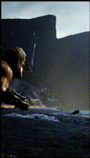
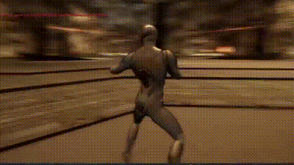
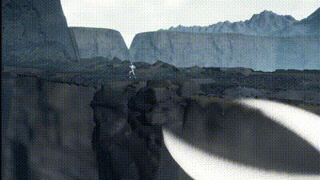
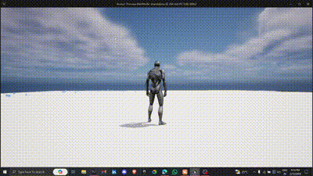
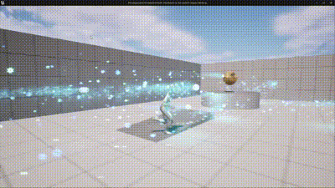
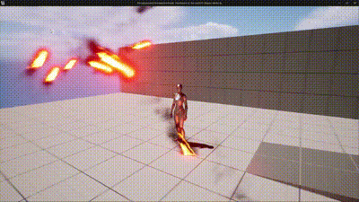
Magic System

Slide 13


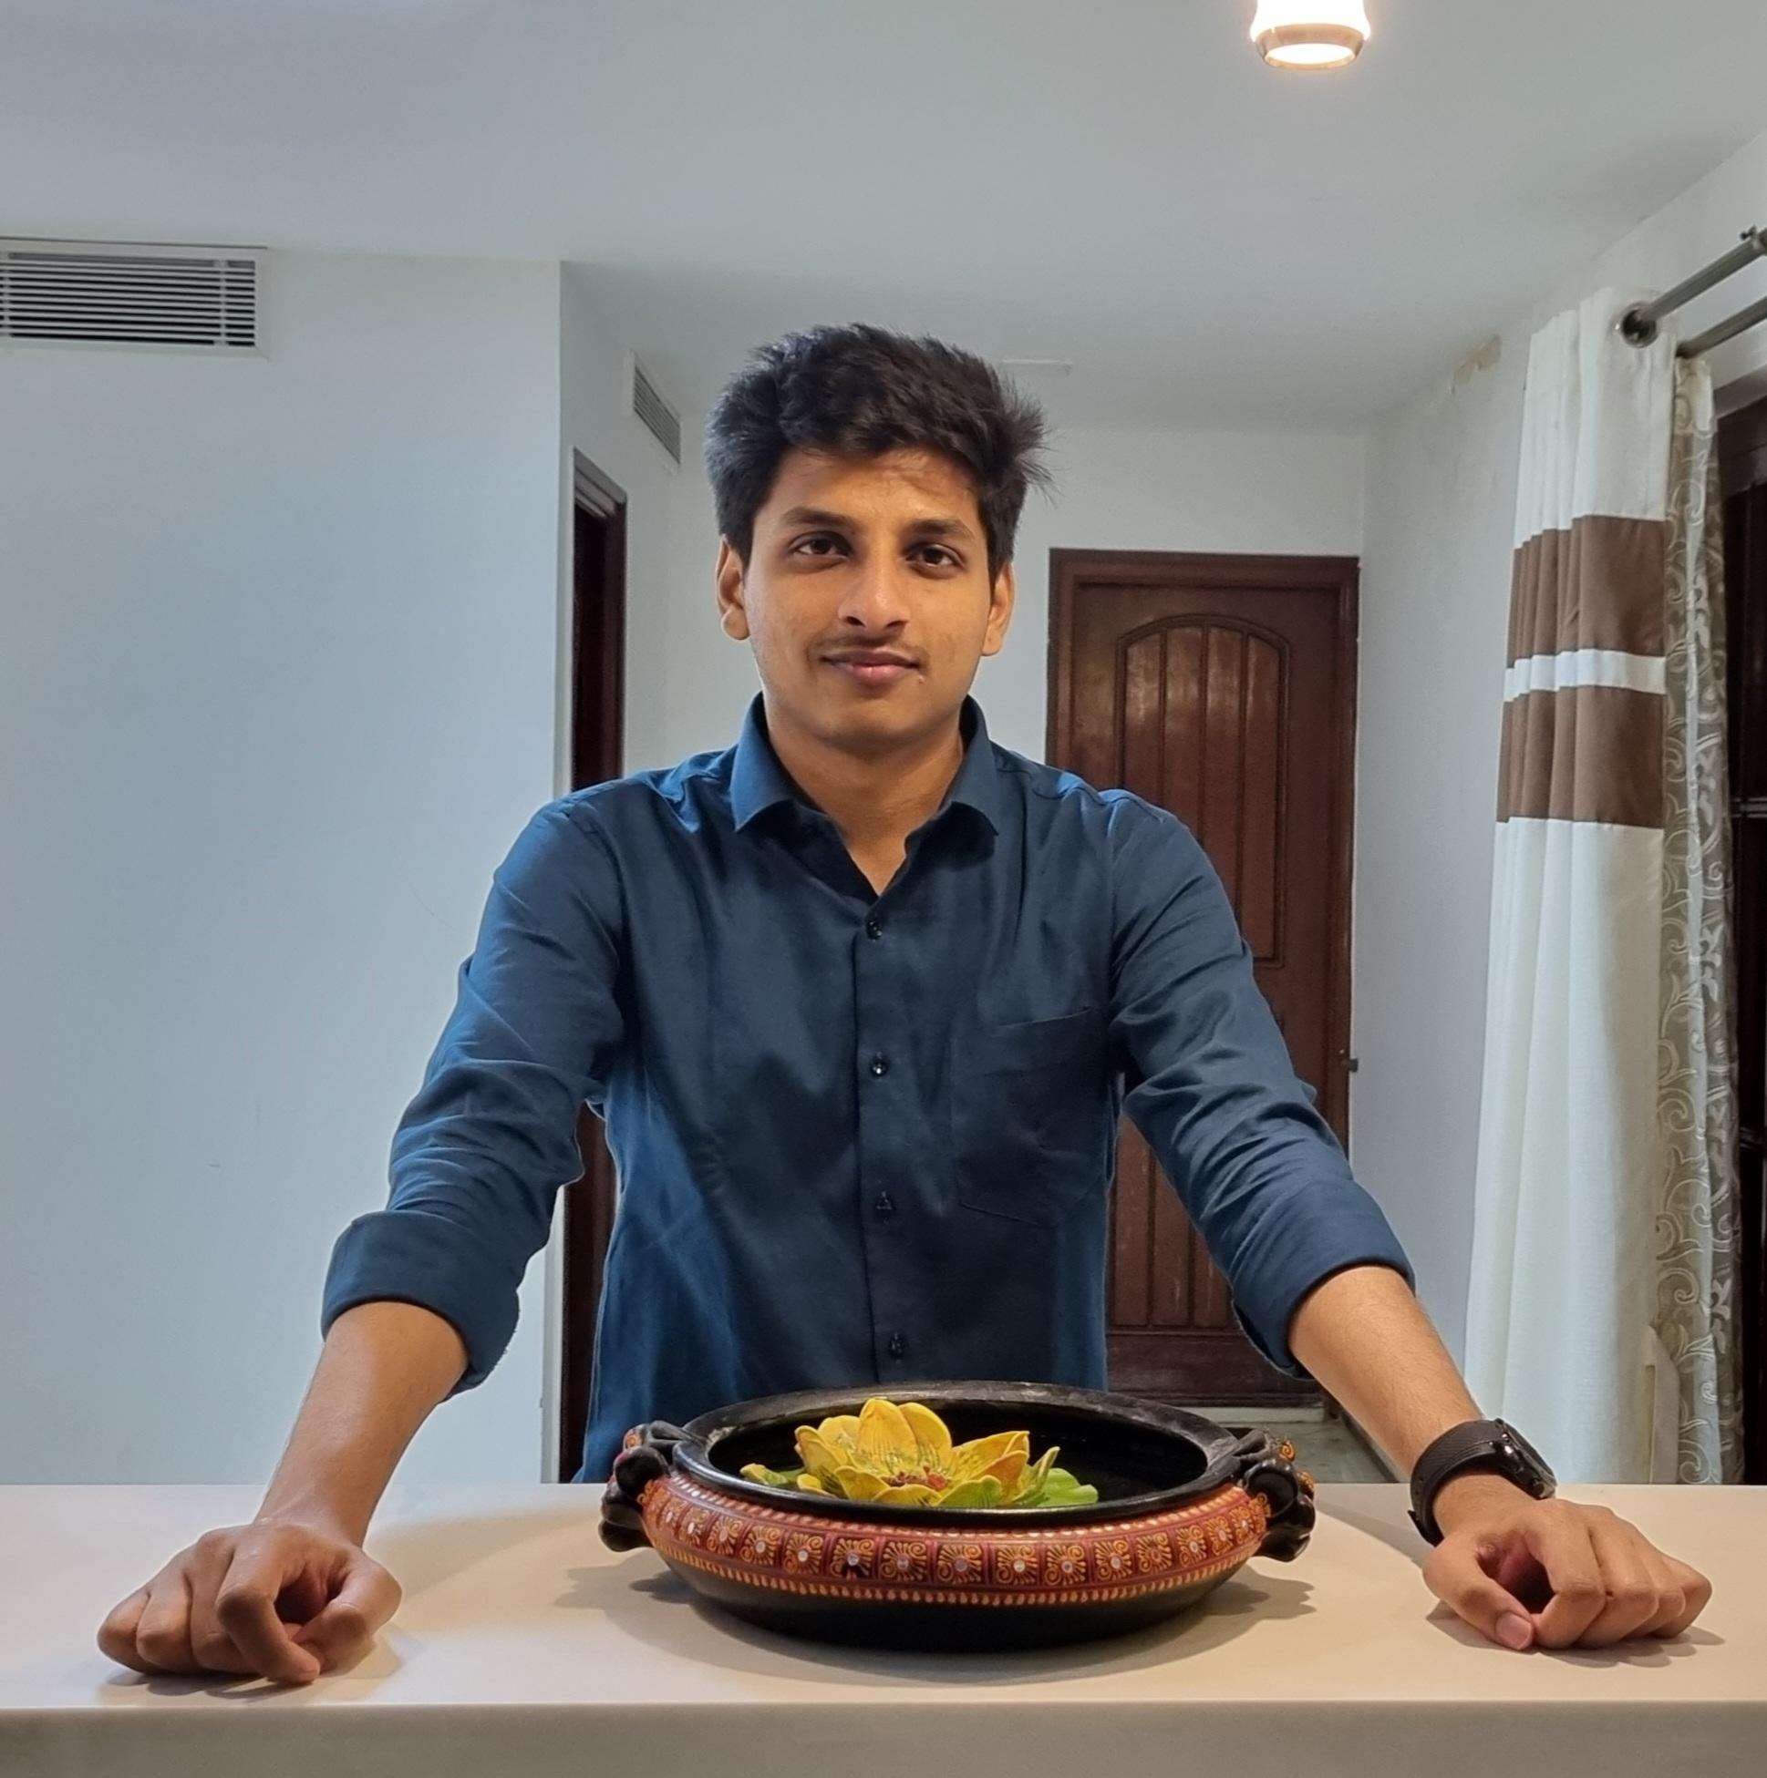
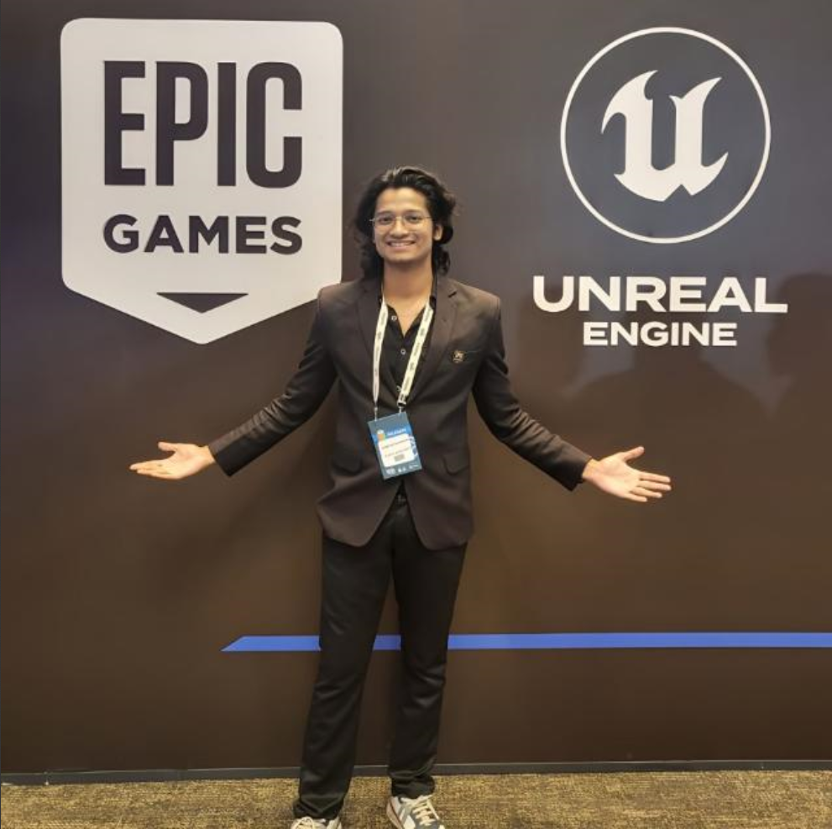
Meet The Team
Abimanyu
Ashwin
Game Developer
Level Designer
Game Developer
Core Mechanics
Siddhesh
Achutha
Game Developer
VFX Systems
Game Developer
AI Systems

Slide 14
Thanks!
Do you have any questions?
mysticwarrior@gmail.com
+91 99648 02864
mysticwarrior.in
All rights reserved.
This game is developed with the mentorship of APlus Associates Pvt. Ltd., India under the Game Development Internship program 2022 and All the Copyrights are Reserved.

